Slide 1



UNIT 1
LESSON 4
HARD TO BELIEVE
Part 4

Slide 2
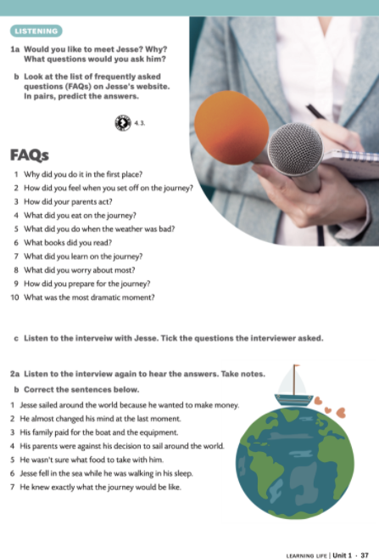
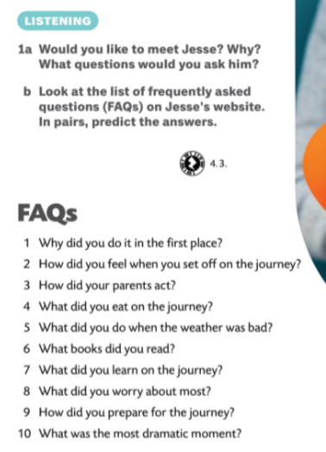

Jesse Martin

Slide 3
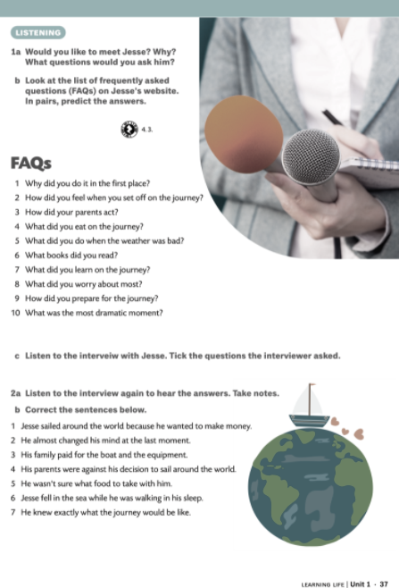
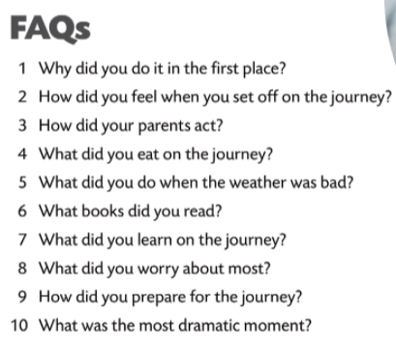

nutritionist - an expert on the subject of nutrition
supportive - showing agreement and giving encouragement
scurvy (= skorbut) - an illness of the body tissues that is caused by not having enough vitamin C
sponsor - a person or an organization that pays for or plans and carries out a project or activity
What did the nutritionist do for Jesse?
How do you know that his parents were supportive?
Who had problems with scurvy in the past? What did the sponsors do for Jesse?
What do people do if they have a last-minute doubt?
Why didn’t Jesse have any last-minute doubts?

Slide 4

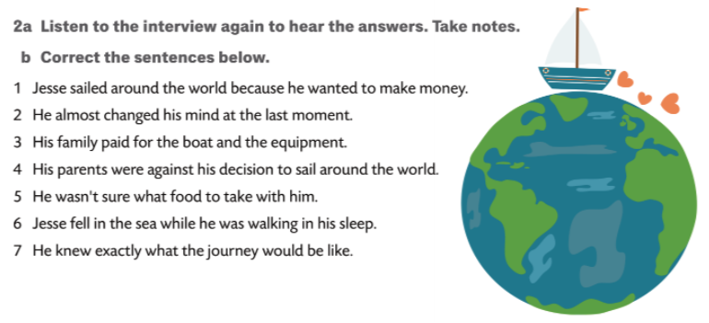
1 No, he wanted to test himself.
2 He didn’t, he didn’t have any last-minute doubts.
3 He had sponsors who gave him his boat.
4 His parents were very supportive. They were not against his decision.
5 He had no problems because he had a nutritionist who told him what and how much to eat.
6 No, he didn’t. he was just afraid that he would fall asleep while sleepwalking.
7 No, he didn’t know what to expect.

Slide 5
What do you think about him?
What was the hardest thing of all?
How did he cope with the problems?
What is he most proud of? Why?
What was the most interesting part of the journey? Describe it.
Do you like his parents? Why?
Do you think you could do something similar?
Do you have anything in common with Jesse?
What are you proud of?
Name at least three things.
Do you think that parents should be supportive? Why?
How can you cope with school?
What can make you shake with fear?

